Slide 1
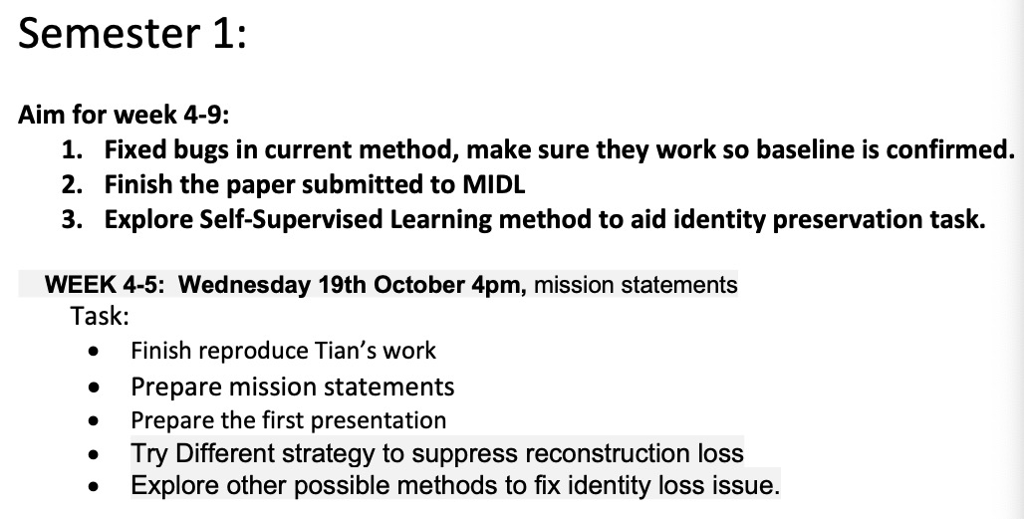
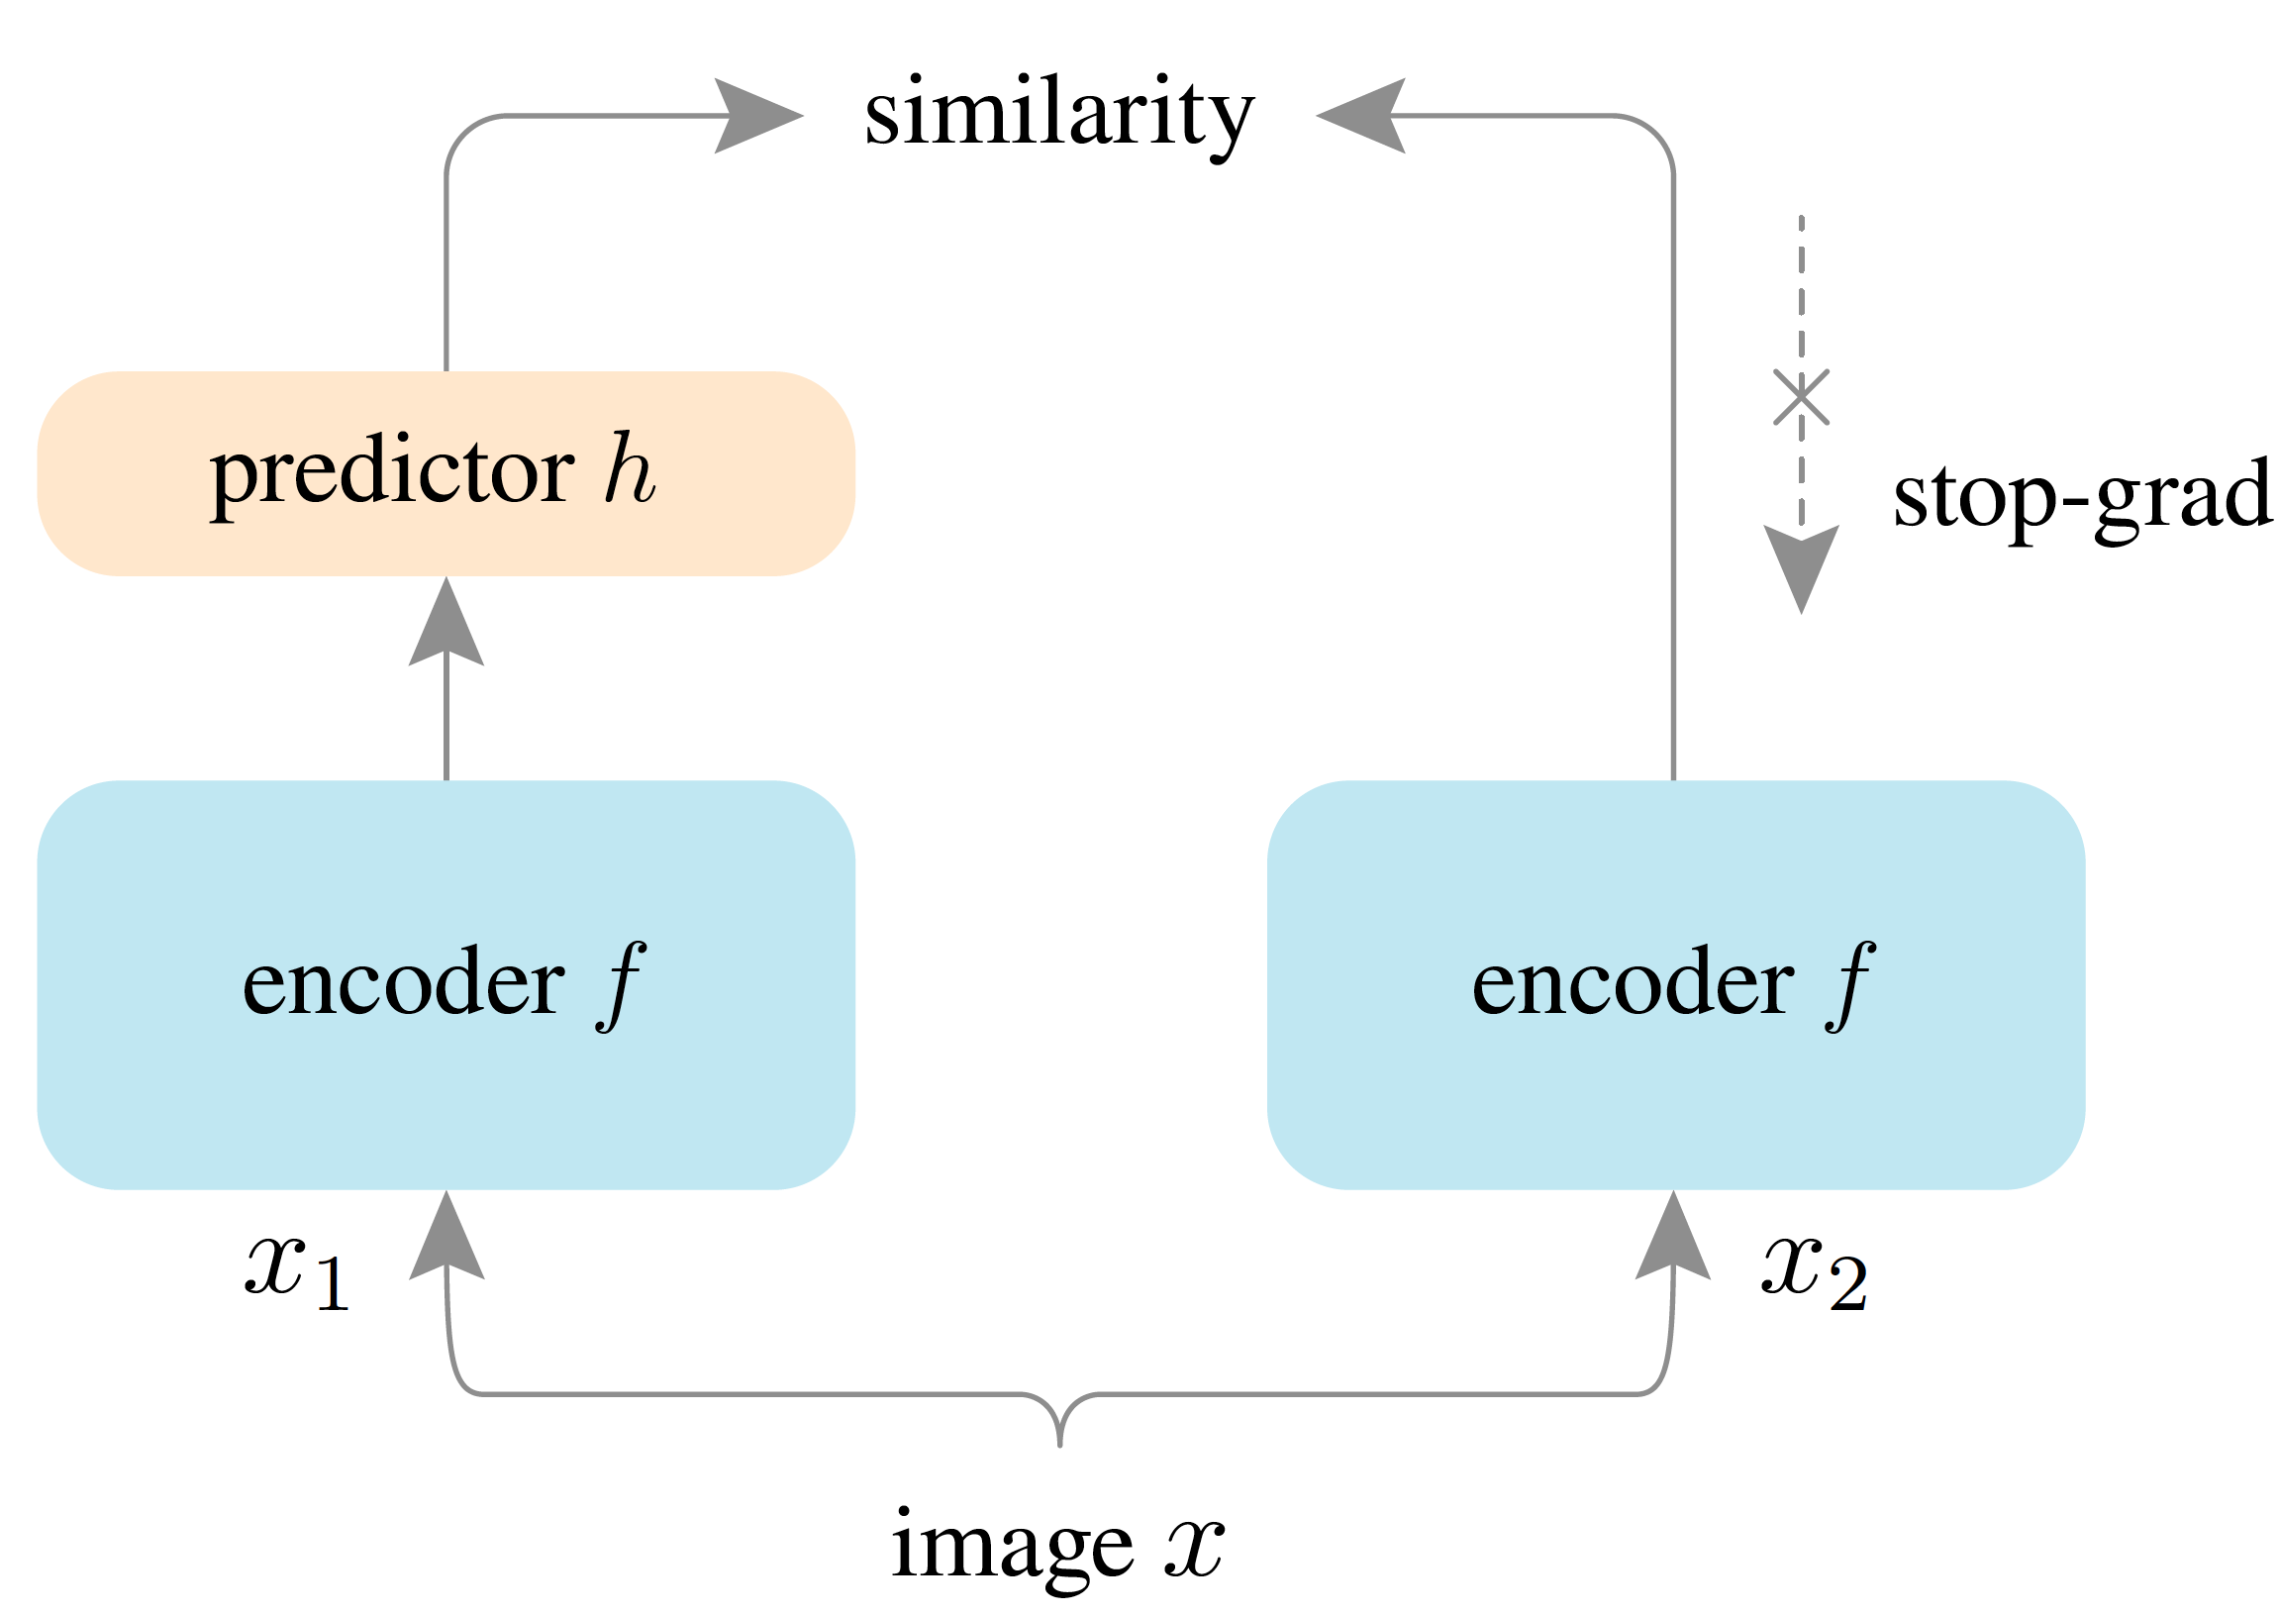
Quick Summary :
Current process is better than the baseline.
Autostop works with no noise on the image.
Pending task:
Reproduce Tian’s work( in progress )
Since simple substruction works, not sure whether it is necessary to find better strategy
Coding is not finished for simsiam and toy dataset .
Meeting Topics:
Agreement with Mission Statement.
Current Process about summer work and possible publishment.
Ideas about pushing BEng project forward.

Slide 2
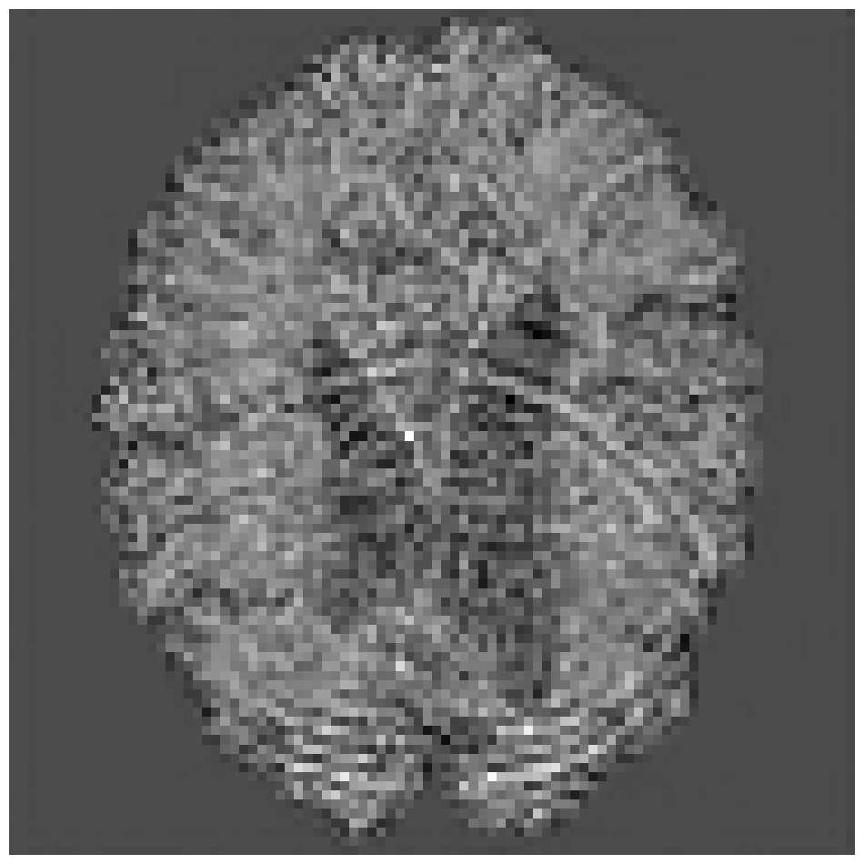
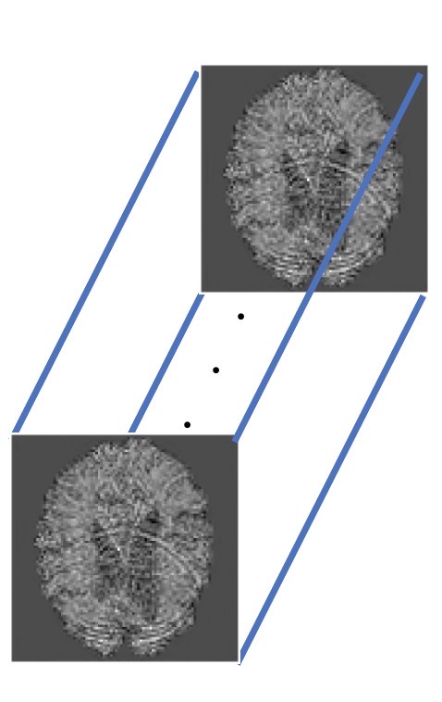
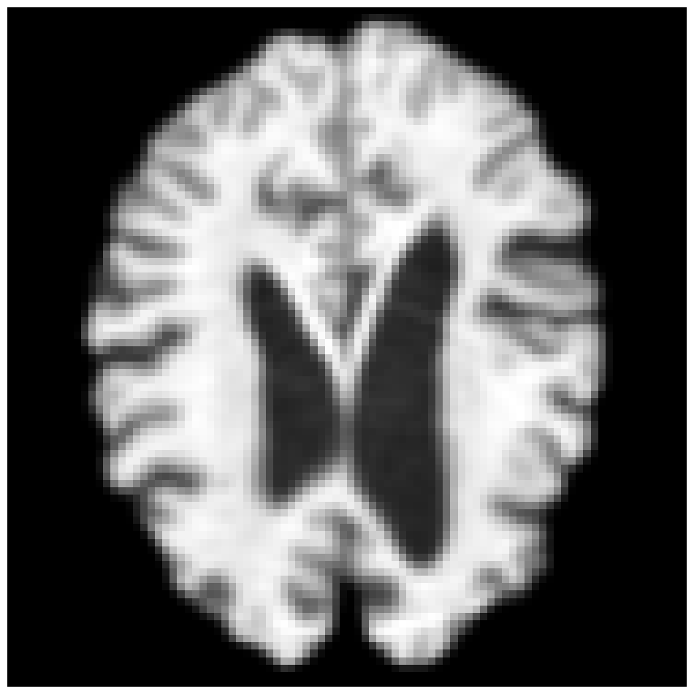
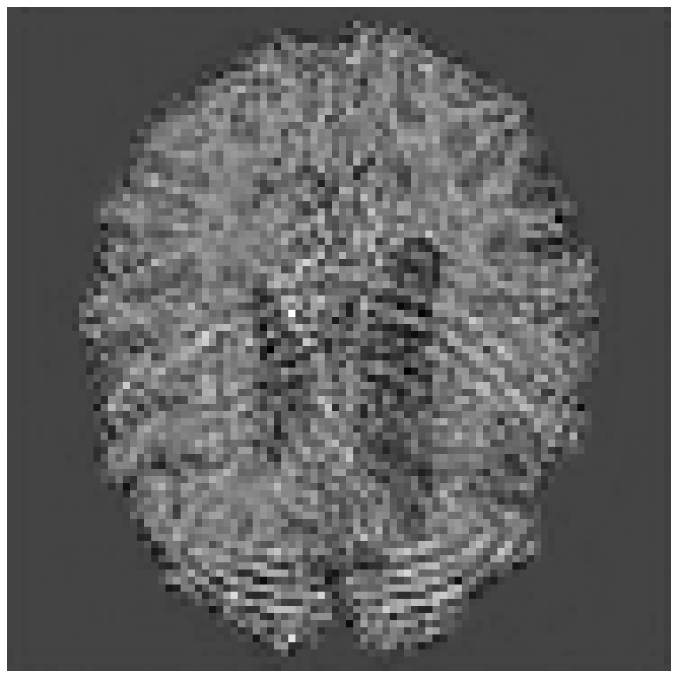
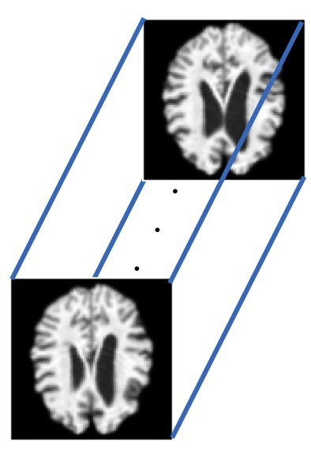
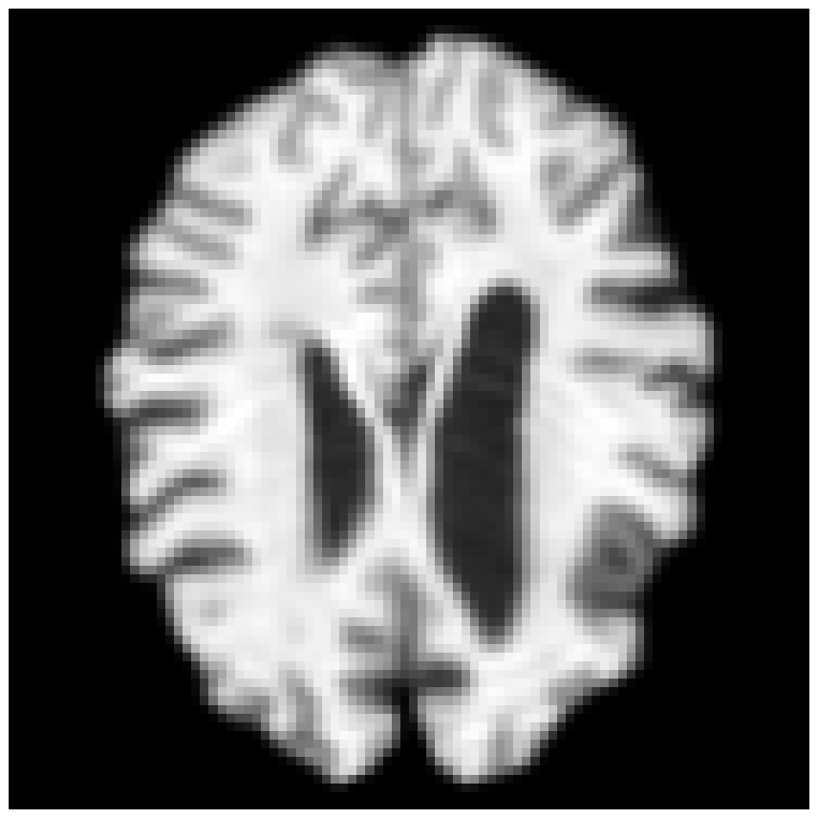

Slide 3
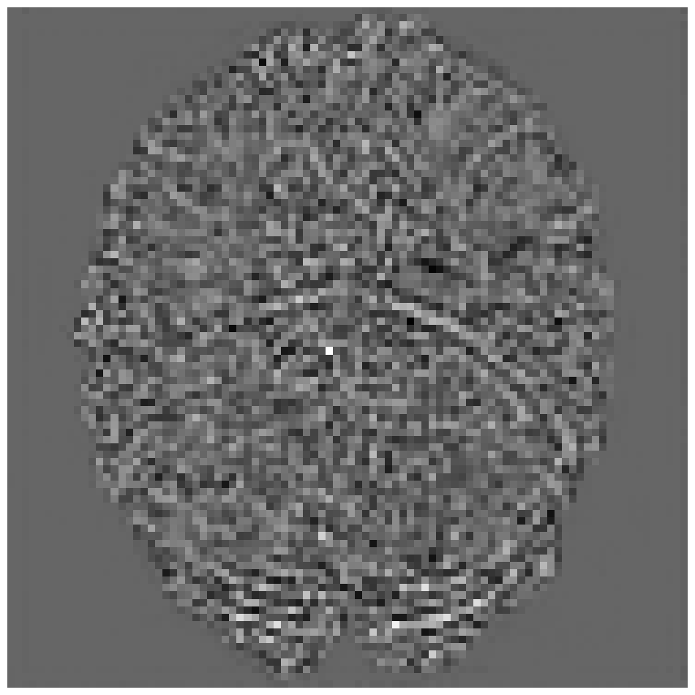
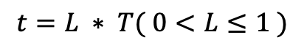
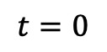
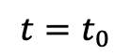
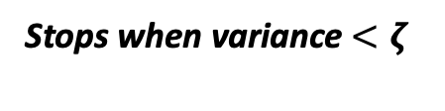
Abduction of Exogenous Noise Stage
Slices within a batch
Regressor
Variance among batch
Autostop
Stops when variance $<ζ$
❌
$$t=0$$
$$t=t_{0}$$
$$t=L ∗ T( 0<L≤1 )$$
Generation under Intervention

Slide 4
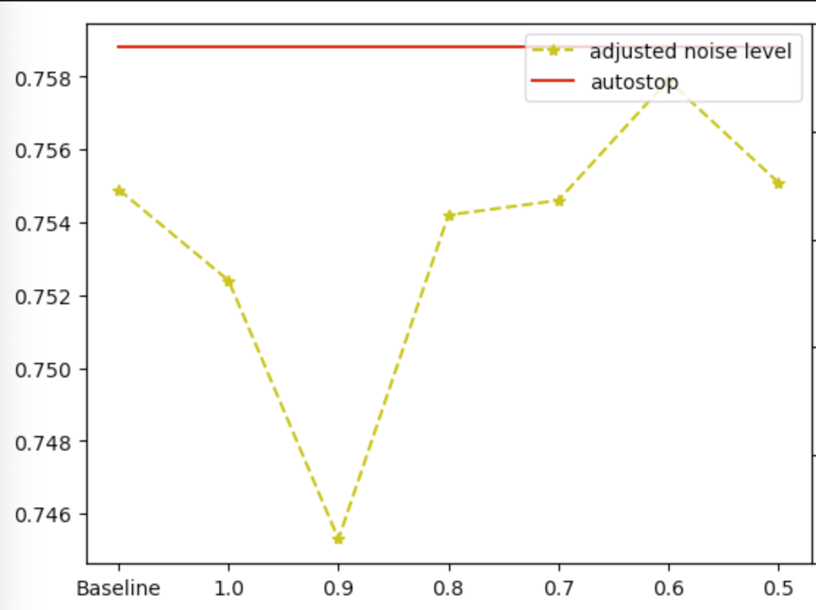
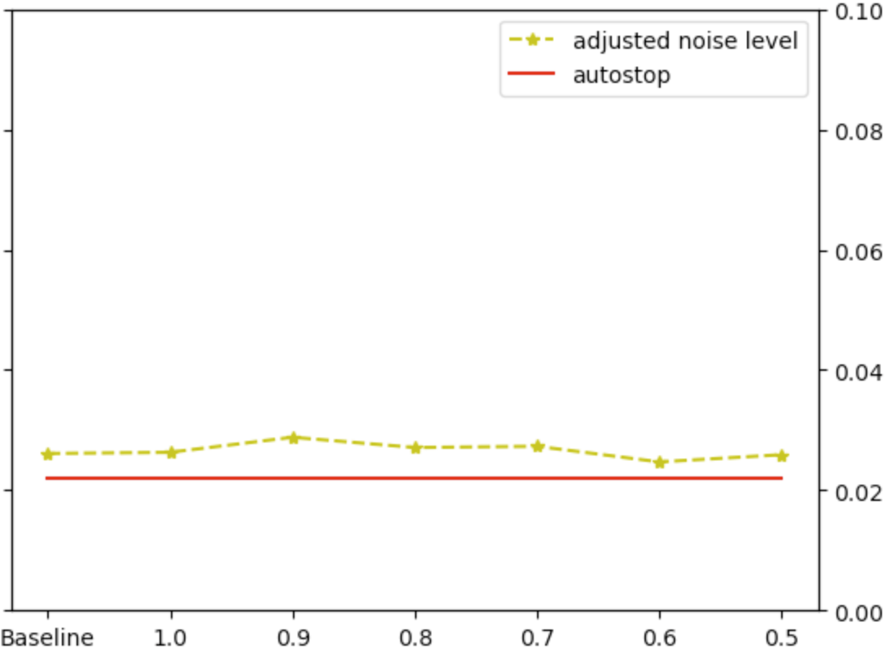
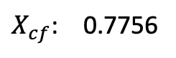
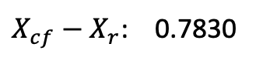
Reconstruction loss:
Simply apply difference reconstruction helps:
$X_{cf}−X_{r}$: 0.7830
Improve the performance about 3%
$X_{cf}$: 0.7756
Autostop mode helps to find optimal:
SSIM
MSE
Improve the performance about 10%
Next move:
Divide the experiments into 2 parts, ageing experiments for comparison, rejuvenation to show the effects
If time is sufficient, works on another dataset for classification task to provide stronger evidence for autostop.

Slide 5
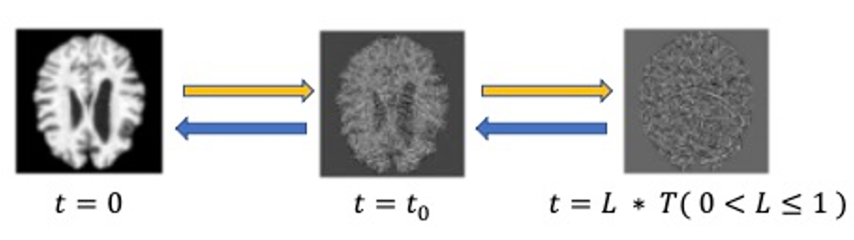
Observations

Slide 6
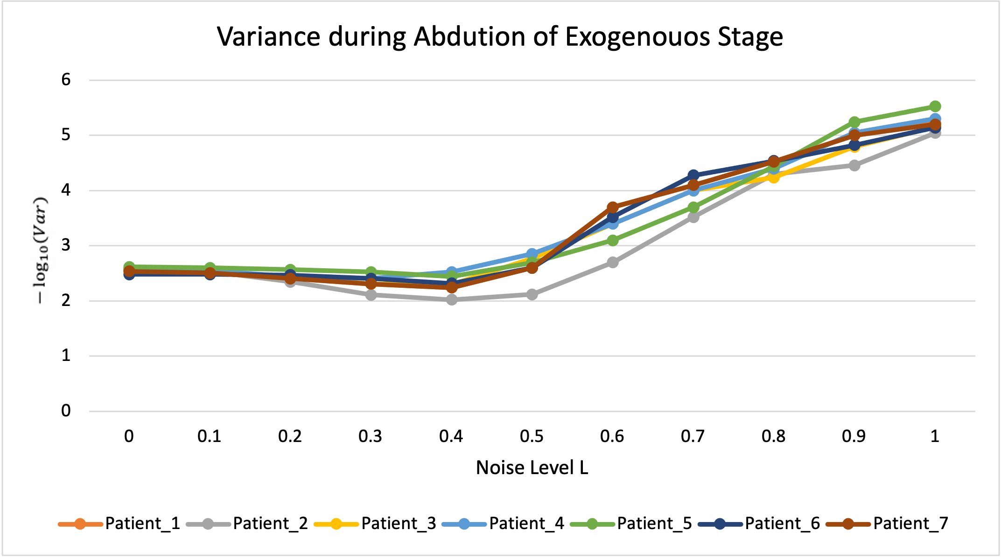
Observations
$−\log_{10}{Variance}$ during abduction of exogenous stage

Slide 7
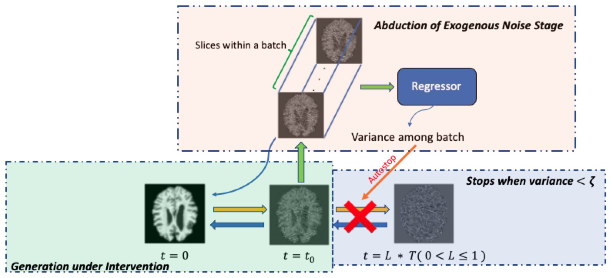
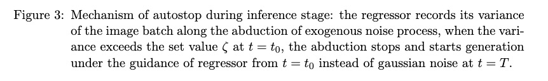
Mechanism

Slide 8
Few Concerns:
Generalization of method, I am confident though lacking of experiments
Relation between cross entropy and variance
The output also depends on timestep t. ( Verify quickly)

Slide 9
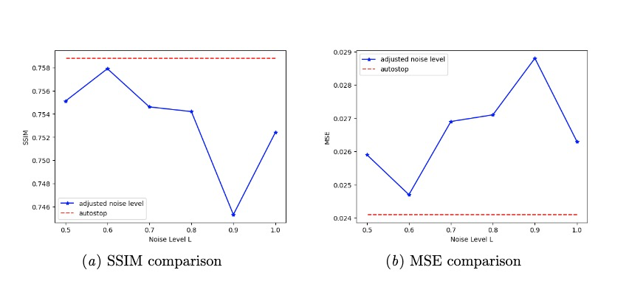
Effectiveness
Certain Individual:
Dataset Prospective:
Missing quantitively data because L < 0.5 is still running.
But it definitely works better than fixed L .

Slide 10
Brief Summary
What I’ve done:
Found the bug in counterfactual inference, the model training will finish today.
Started classifier-free guidance coding, and will finish by the end of this week.
Paper script

Slide 11
Worries about the method:
External guidance
Benefits:
Adapt to multi-task for different counterfactual tasks without re-training.
Drawbacks:
The external classifier cannot be joint training.
Counterfactuals might be counteracting.

Slide 12
Worries about the method
Classifier free:
Benefits:
Better performance.
Possible joint training to achieve the balance between identity preservation and counterfactual estimation.
Drawbacks:
Retraining for different task
Cost

Slide 13
Baseline for comparison
Bad performance:
Reproduction: 0.72 vs Org: 0.76 Try fine-tuning it or keep it?
Another Baseline( In construction )

Slide 14
Novelty and Impact
New method on ANDI -- Not a huge improvement with a single factor.
Optimal Noise Level Searching – A comprehensive method, however, other people now tend to use classifier-free.
Age measurement for comparison – Which one should I use? VGG-like network(Preferred) or current regressor trained on clean images?

Slide 15
Next Step…
Finish reproduction and renew the script.
Three methods for comparison.
Any suggestion? My thought is to try MIDL first, if it does not get accepted, then improve it with 3D-Brain.

Slide 16
Definition of the Problem
What we want: extract identity being invariant to age.

Slide 17

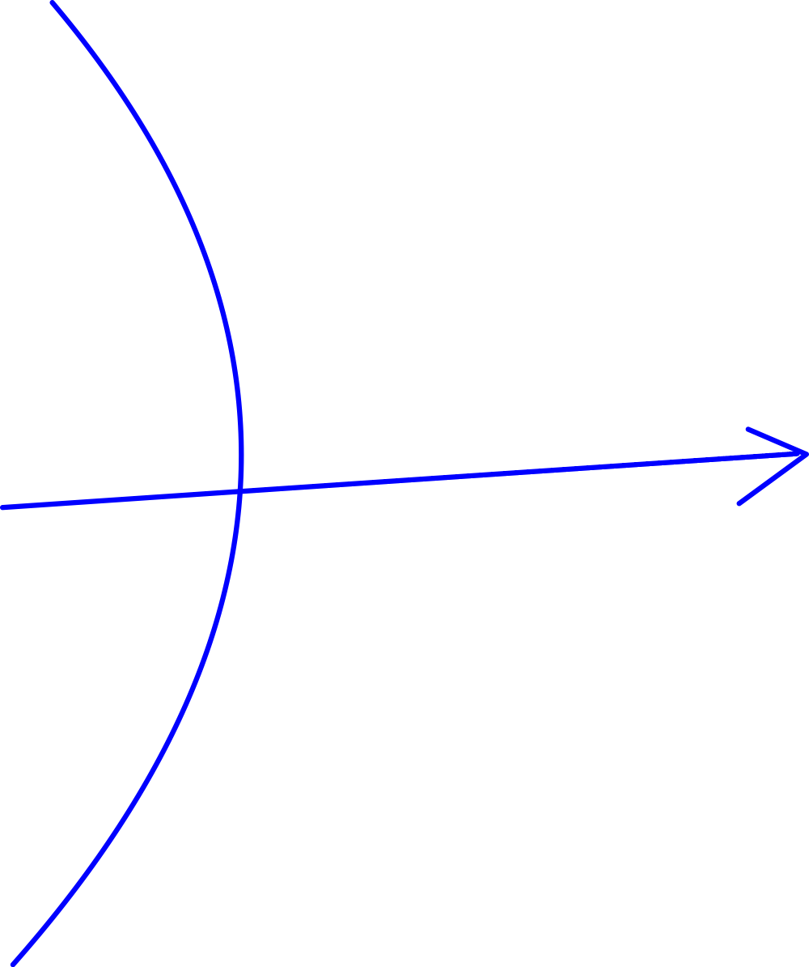
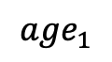
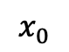
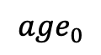
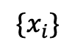
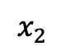
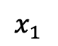
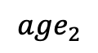
For patient_0, if we got…
feature extractor z=F(X)
$${age}_{0}$$
Question_1: how do we learn z and F to be unrelated to age
$$x_{0}$$
F(x)
Z, constant means it is related to identity but unrelated to age
$${age}_{1}$$
Feature_Extractor
learn a Y=D(z) that can extract identity being invariant to age
$$x_{1}$$
age = f_age(z)
$${age}_{2}$$
$$x_{2}$$
age = f_age()
$${\{x}_{i}\}$$

Slide 18
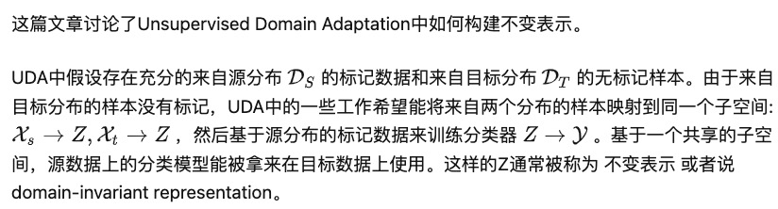
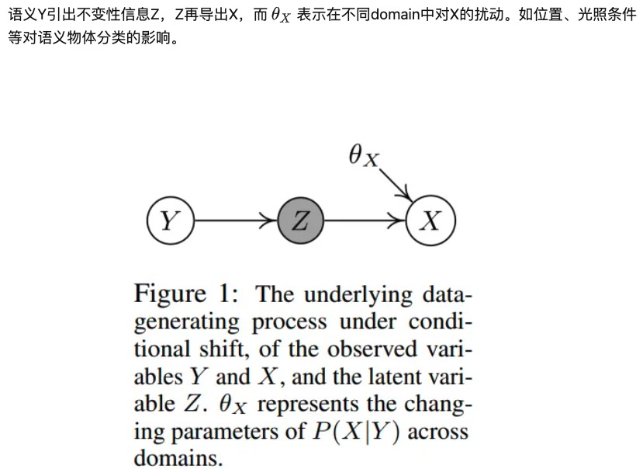
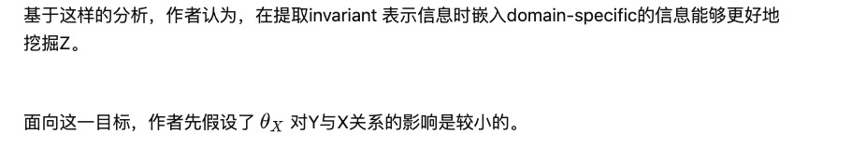

Slide 19
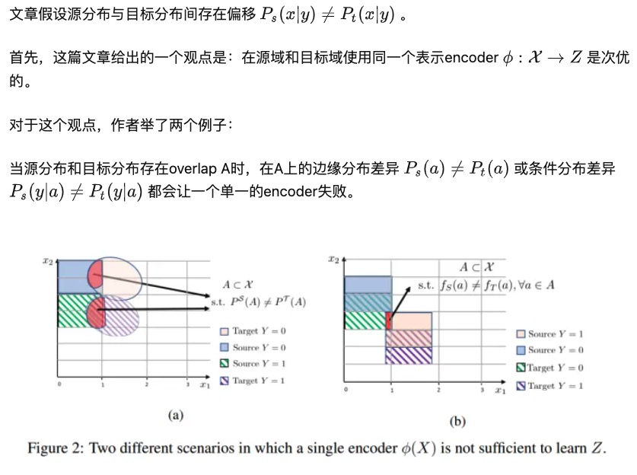

Slide 20
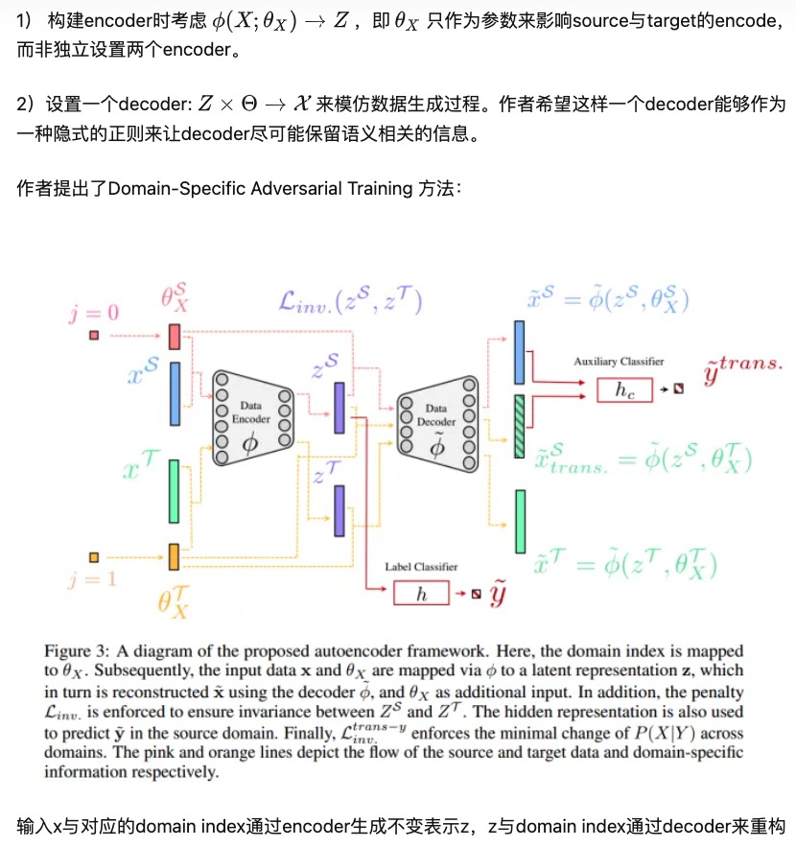

Slide 21
Domain-Invariant Mapping Network (DIMN)
is designed to learn a mapping between a person image and its identity classifier, i.e., it produces a classifier using a single shot.

Slide 22
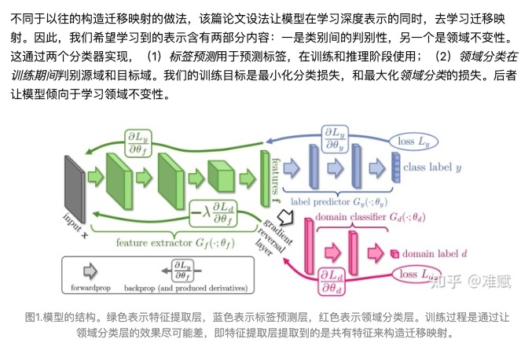
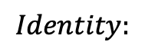
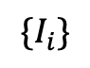
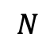
For N number of patients…
$$Identity:$$
$${\{I}_{i}\}$$
$$N$$

Slide 23
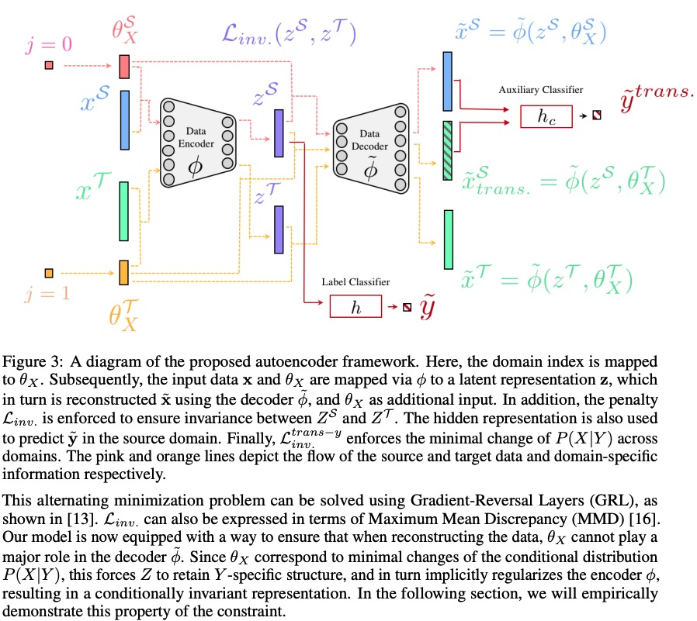
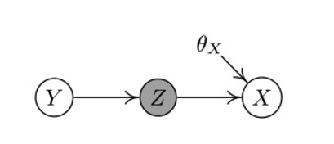
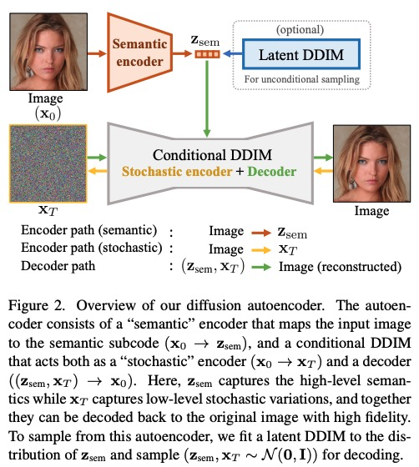
Similar Architecture6

Slide 24
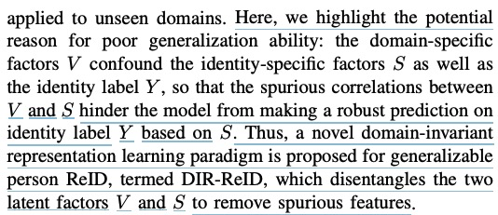
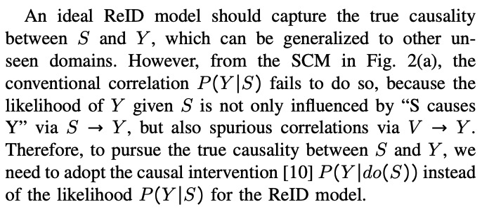
Generalizable Person Re-identification
Setting: SCM among identity labels_Y, identity-specific factors_S(clothing) and domain specific factors_V(background).
Method: Disentangle the 2 factors into independent feature spaces.

Slide 25
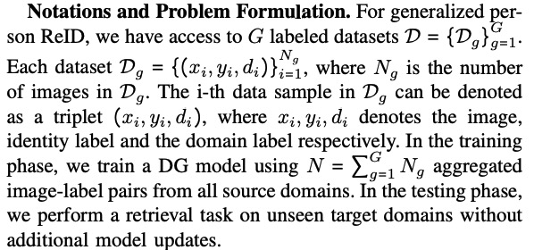
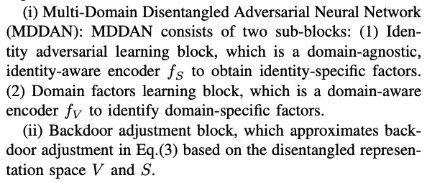

Slide 26
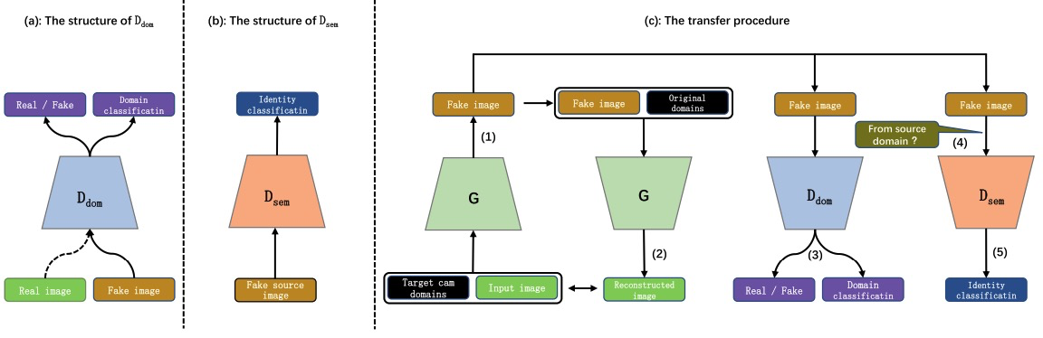
Semantic Encoder:

Slide 27
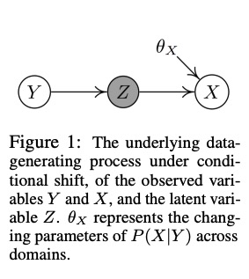
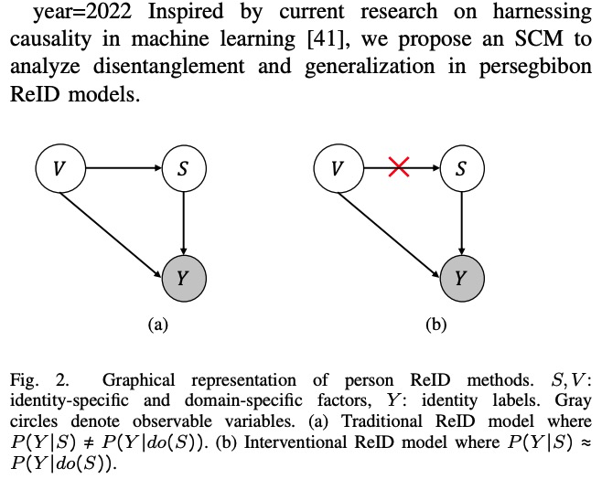

Slide 28
Back to our problems
We don’t have unannotated large dataset.

Slide 29
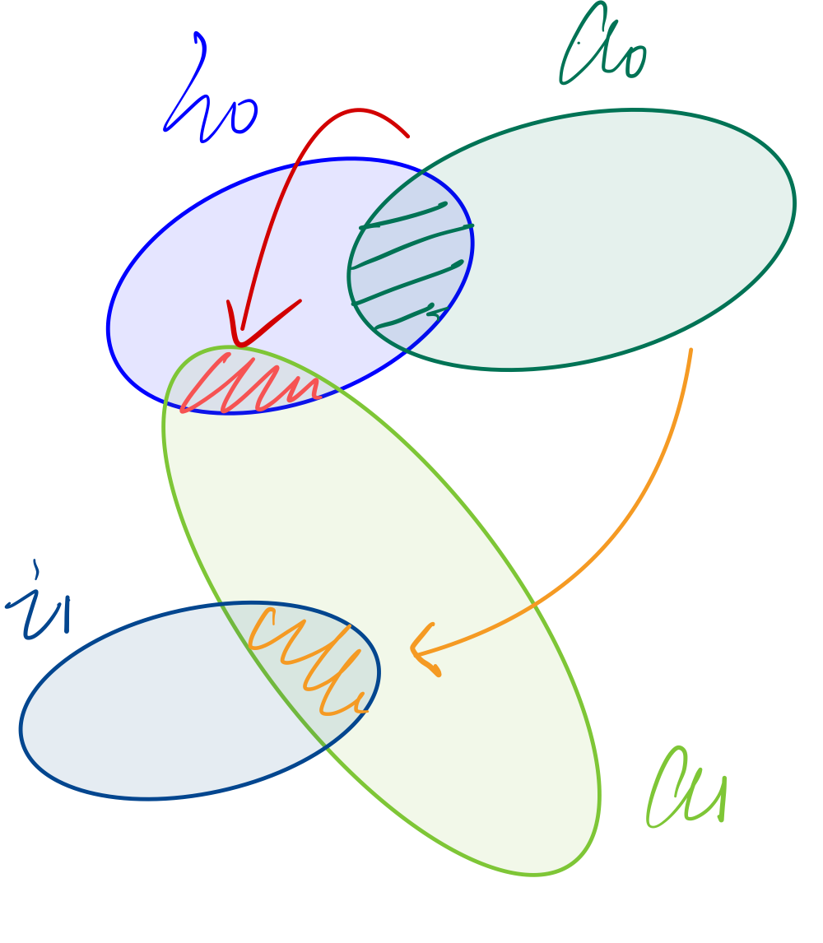

Slide 30

Revisit Background Knowledge
Overall Structure

Slide 31

Revisit Background Knowledge
Semantic Encoder
Preserve most semantic information
Then use an optional DDIM to sample it.

Slide 32

Revisit Background Knowledge
Stochastic encoder
Used to construct only the information left out by semantic representations.

Slide 33
Progress update overview
Codes: Finished building current ideas. All encoders share a same structure.
FFHQ: Complete Set(dataloader, decoder, DDIM…) However, no labels.
ADNI dataset:
Build data loader, decoder, stuck in DDIM part..(Pending.) Age Prediction Dataset on Kaggle(Currently Inferring):
Contains images of different ages from 20 to 50, there are a batch of images belonging to different identity in each age .
Complete Set(dataloader, decoder, DDIM…) Baseline Setup, as the method, did not include preservation.[Done]

Slide 34
Revisit Idea
Semantic Encoder -> Extra main semantic information
Maybe an identity Encoder to extra identity information?
Stochastic Encoder -> Construct information left by a semantic encoder
Maybe use diffusion autoencoder to construct isolated from identity?
How to build an identity extractor lacking of enough longitudinal data?

Slide 35

Revisit Idea
Overall Structure

Slide 36

Revisit Idea
Identity Extractor, two-branched way.

Slide 37

Evaluation – External Net
Original_img
Pre-trained 2-branch Net
Yes/No?
Drawback: cannot establish unified metrics for all datasets.
Generated_img
Other General Metrics: SSIM, PSNR(not longer using MSE)

Slide 38
Possible Improvement(Next Step)
Is the linear combiner C expressive enough? Try other networks to combine the vectors together, with Conv + MLP.
Is identity preservation a bit rough and hard? As the identity information highly depends on the extractor.
How to train the external classifier to guide the process?
on Xt only or on (Xt, Zsem)? Ideally, Zsem would only contain age-non-related information.
Which metric should we use to better distinguish Zidentity? Currently, we are using cosine similarity…

